Slide 1
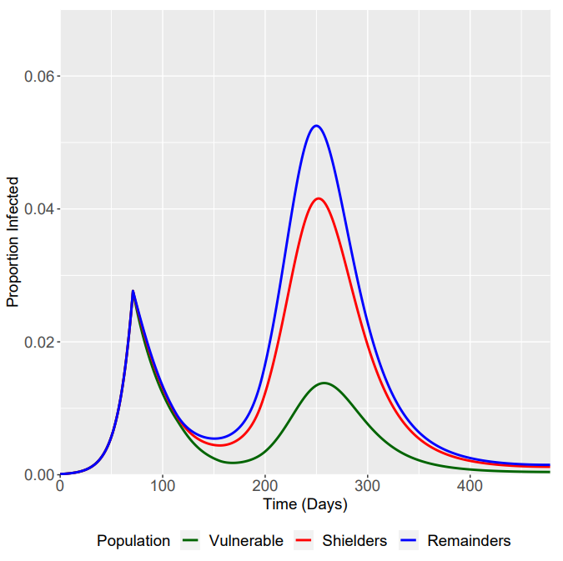
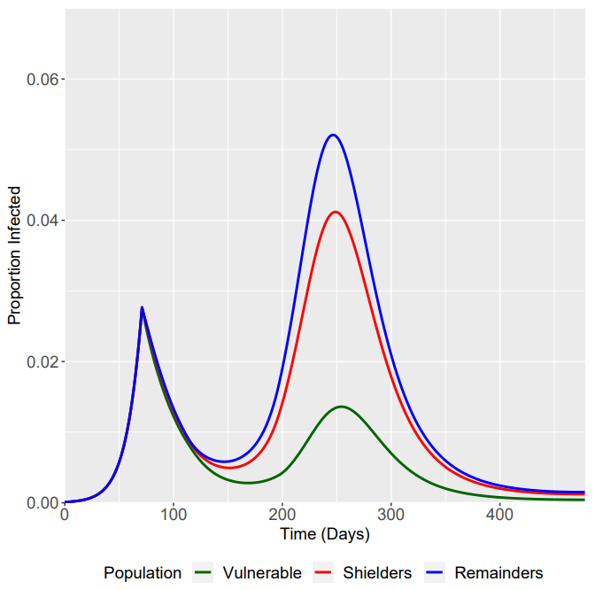
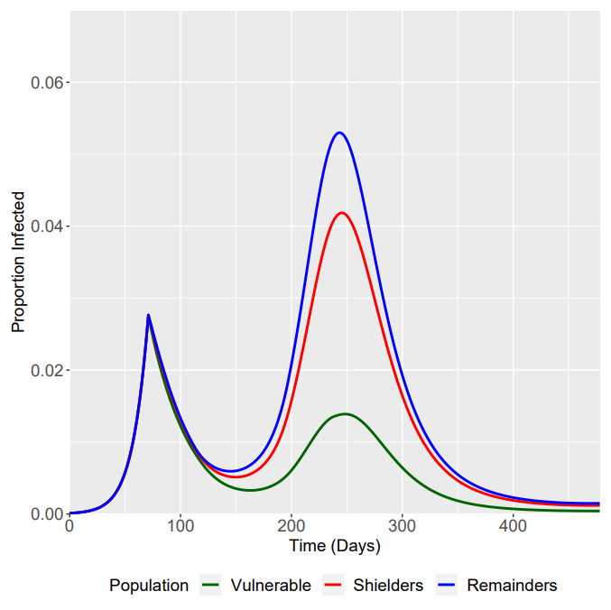
β₂/β₃ - 12 Weeks Ramp Up
β₁/β₄ - 6 Weeks Ramp Down
β₂/β₃ - 12 Weeks Ramp Up
β₁/β₄ - 12 Weeks Ramp Down
β₂/β₃ - 12 Weeks Ramp Up
β₁/β₄ - 18 Weeks Ramp Down

Slide 2
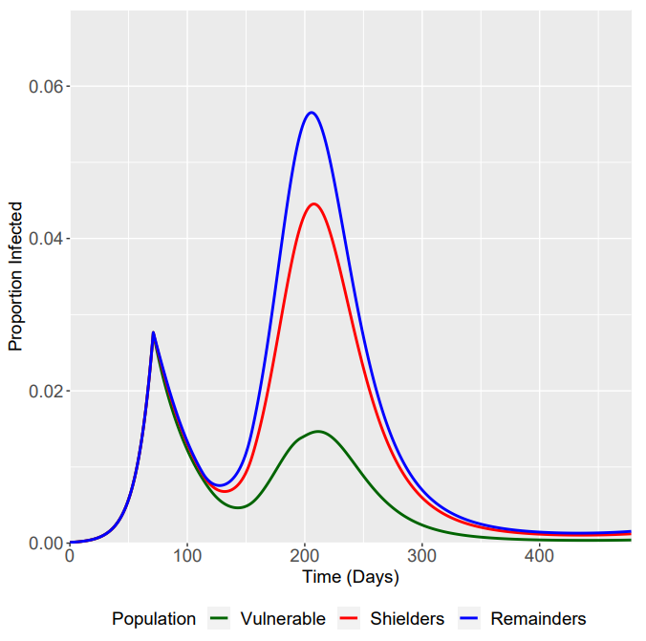
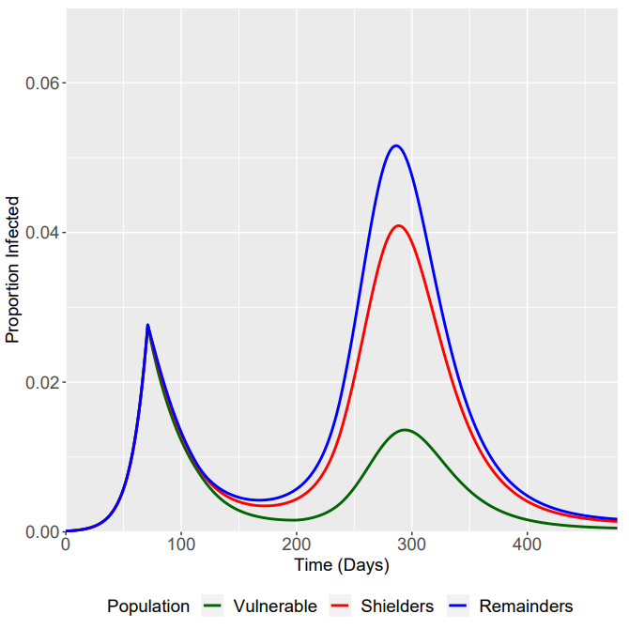
β₂/β₃ - 6 Weeks Ramp Up
β₁/β₄ - 12 Weeks Ramp Down
β₂/β₃ - 12 Weeks Ramp Up
β₁/β₄ - 12 Weeks Ramp Down
β₂/β₃ - 18 Weeks Ramp Up
β₁/β₄ - 12 Weeks Ramp Down

